Slide 1

VIDEO STREAMER-HUMAN LIBRARY
Supervisor : Ms.R.Aishwarya
Name of the Student : Varun Das.G
Register Number: 39111063

Slide 2
CERTIFICATE

Slide 3
PRESENTATION OUTLINE
Abstract
Introduction
Objectives
Requirements
Project Implementation
Workflow Diagram
Screenshots
Future Application
Conclusion
References

Slide 4
ABSTRACT
Human Library is very much like a regular library ,where the books are all human volunteers who have opted to speak about their experiences openly to an interested audience and answer any questions they are asked.
The main goal of the Human Library consisted of three main objectives; to bring different social and ethnical groups of society together, to challenge (and overcome) prejudice, stereotypes, and discrimination in society, and to learn, educate, and change attitudes.
In this project, the concept of human library has been implemented virtually as video streamer. This video streamer consists of “virtual book” that are human in video format. Each of these books volunteer to take part in the library by uploading their videos and share their story .The virtual human library has bookstacks with different books(videos).Readers can also schedule appointment with any specific book if interested.

Slide 5
INTRODUCTION
Human libraries provide readers with access to the knowledge and personal experiences of their fellow community members. Human books stand to benefit from participation as well, in various ways ranging from altruistic to self-focused.
The main purpose of this project is to bring people from different communities together to share their life experiences in a video streaming platform.
Human library events depend on the services of the “human books” who volunteer to participate, though recruitment of these volunteers remains one of the most challenging aspects of hosting the events. Making this concept virtual can bring more books to volunteer and experience sharing could be done efficiently.

Slide 6
OBJECTIVES
The primary objective of this project is to develop a video streaming website which acts as a human library.
To bring human books from different locations in a common platform for sharing their life experiences.
Readers can also schedule appointment with the human books if they are interested to know more about the specific book they have read.
The Human Library is a safe space where we can challenge our unconscious biases, explore diversity, learn about how we're different from one another, and interact with people we'd never meet otherwise.

Slide 7
REQUIREMENTS
SOFTWARE REQUIREMENTS
VISUAL STUDIO CODE
ANY WEB BROWSER
HARDWARE REQUIREMENTS
4GB RAM or above
Graphics Processing Unit(GPU)

Slide 8
PROJECT IMPLEMANTATION
Install Python
Download visual studio code(Code Editor)
Install Django.
Start the project in Django and name the Web application.
Create workspace and initialize application
Create components and make their layout with HTML,CSS and JavaScript.
Backend is implemented using Django

Slide 9
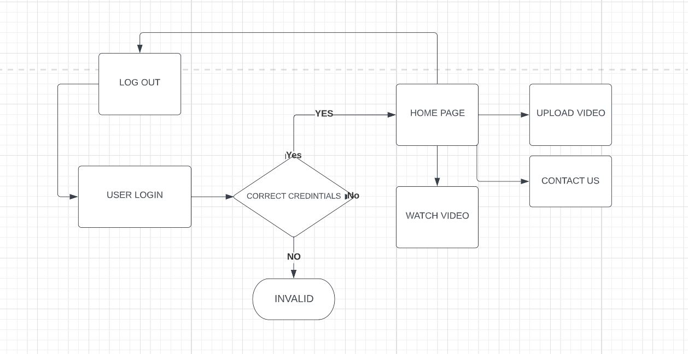
WORKFLOW DIAGRAM

Slide 10
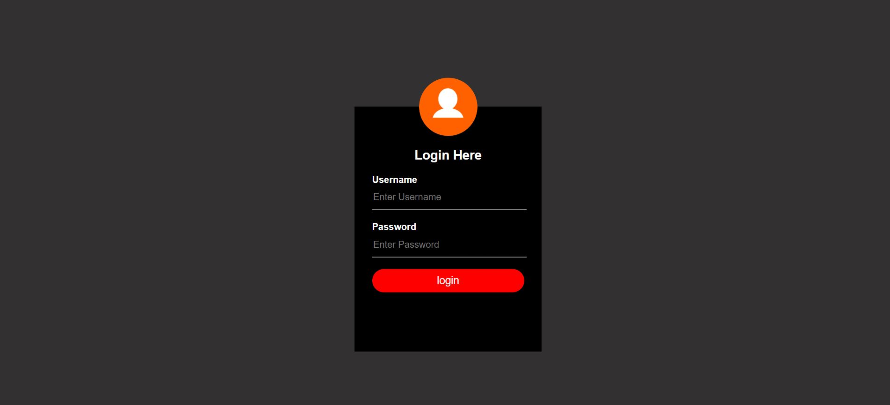
SCREENSHOTS
LOGIN PAGE

Slide 11
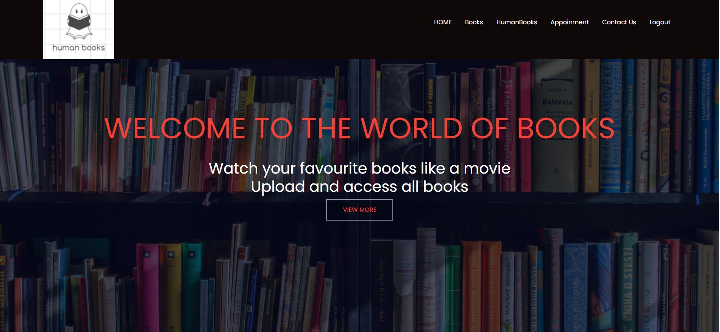
SCREENSHOTS
HOME PAGE

Slide 12
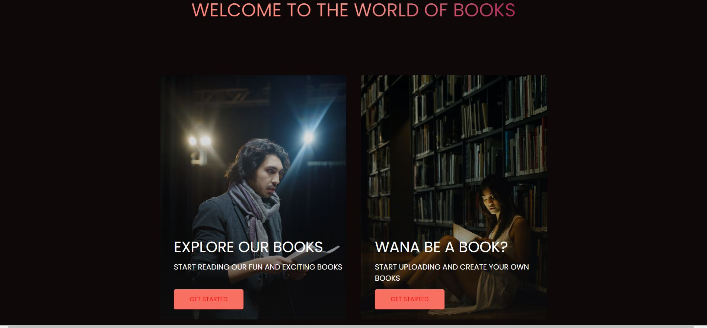
SCREENSHOTS
OPTIONS PAGE

Slide 13
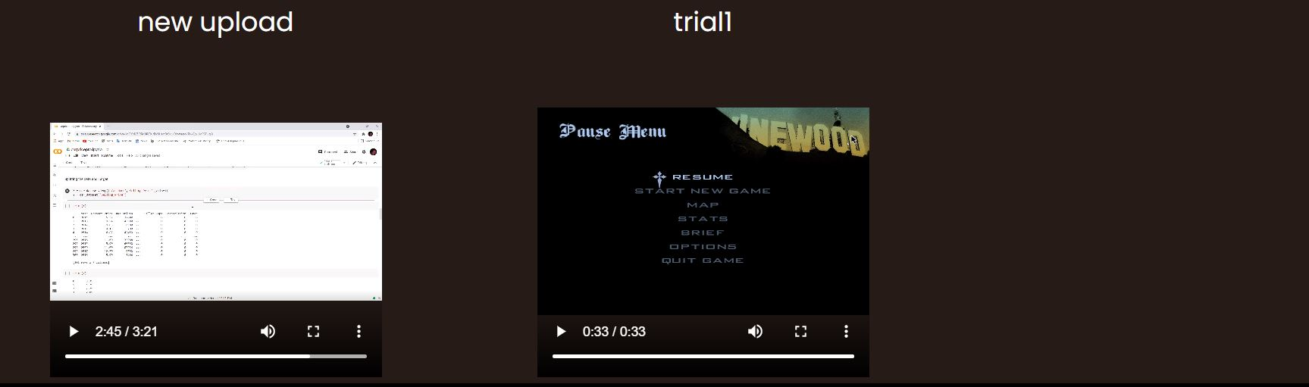
SCREENSHOTS
VIDEO STREAMING PAGE

Slide 14
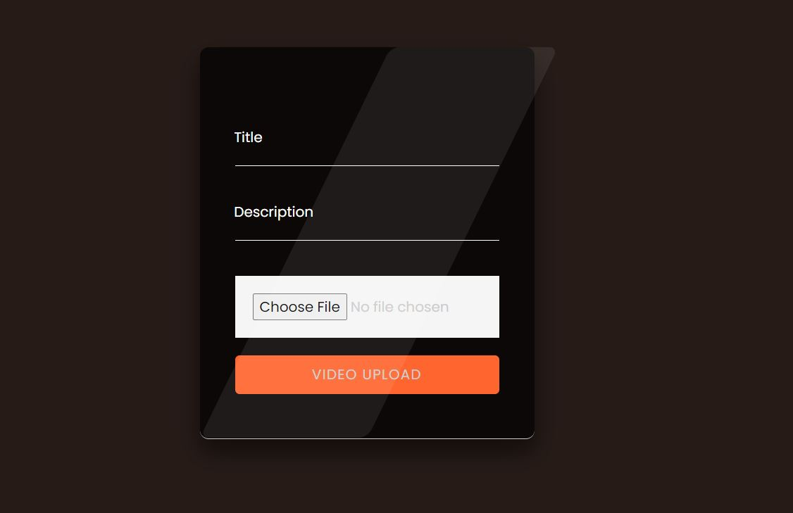
SCREENSHOTS
NEW VIDEO UPLOAD PAGE

Slide 15
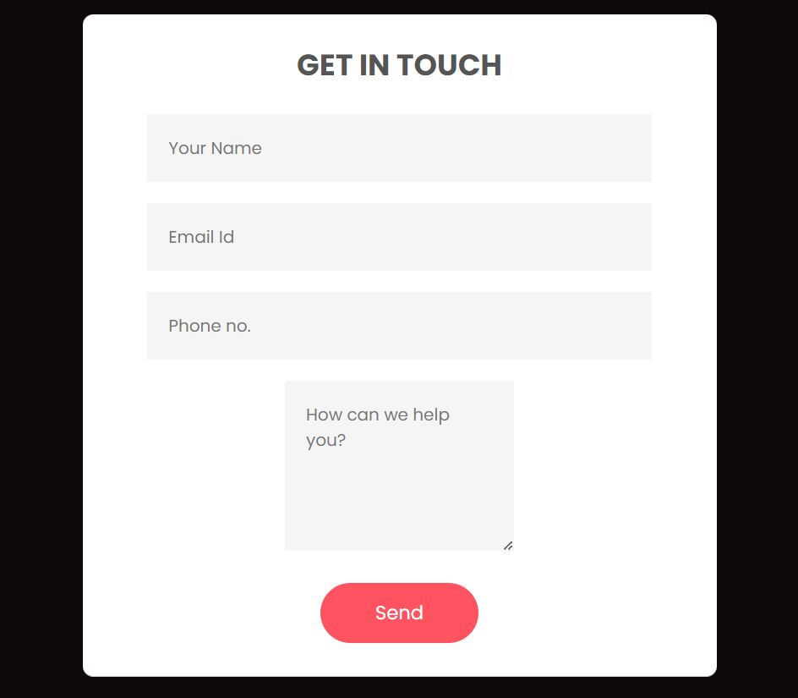
SCREENSHOTS
CONTACT US PAGE

Slide 16
FUTURE APPLICATION
Human library events depend on the services of the “human books” who volunteer to participate, though recruitment of these volunteers remains one of the most challenging aspects of hosting the events. Making this concept virtual can bring more books to volunteer and experience sharing could be done efficiently.
The Covid-19 pandemic has also underlined the need of the Human Library. According to a Pew Research Center report, more than 60% of individuals believe that national divides have increased since the pandemic began. This demonstrates how there has never been a better time to bring people together.
Every person in this world has a story to share with. The concept of video streaming human library can be very efficient in bringing people from different parts of the world together and also to get to know about their life experience.
This video streaming human book library will definitely help people to share their stories and also for people to get to know about different lifestyles.

Slide 17
CONCLUSIONS
In this project we have designed a video streaming website in which people act as human books and share their life experiences with people all around the world. Readers of the book can select any book and watch it in video format. We have also provided login page for the readers and for people who volunteer themselves as human books. If the reader is interested to know more about any specific human book, there is an option to schedule an appointment and get it in touch with them.

Slide 18
REFERENCES
https://getbootstrap.com/
https://fontawesome.com/
https://www.w3schools.com/
https://www.djangoproject.com/
https://www.pexels.com/
Git hub link-https://github.com/VarunDas11901/video-streamer-hcl-internship-

Slide 19

VIDEO STREAMER-HUMAN LIBRARY

Slide 20


